Slide 1
G5 - Smart Office Cleaner Robot
SURBHI TECHNOLOGIES
Guided by ;
Mr.Akshay Patil

Slide 2
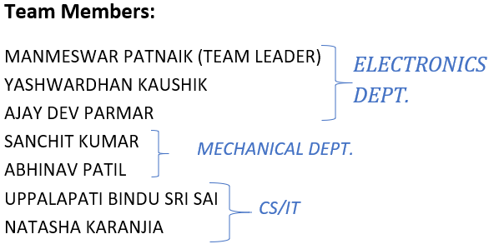

Slide 3
Table of Contents
Product Design
Circuit Diagram
Application Interface
Estimated Budget

Slide 4
Objective
Main goal is to prepare robust, inexpensive affordable product with better efficiency

Slide 5
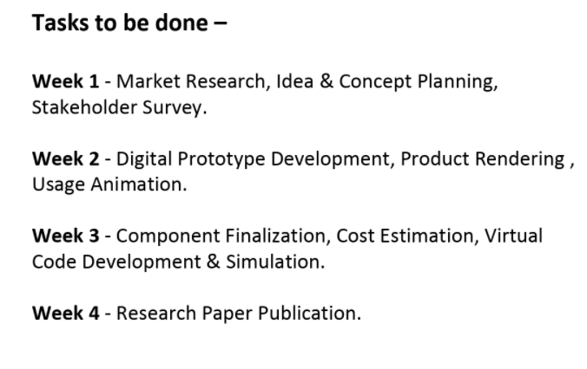

Slide 6
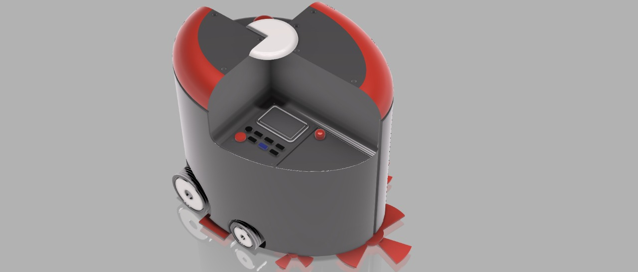
PRODUCT DESIGN

Slide 7
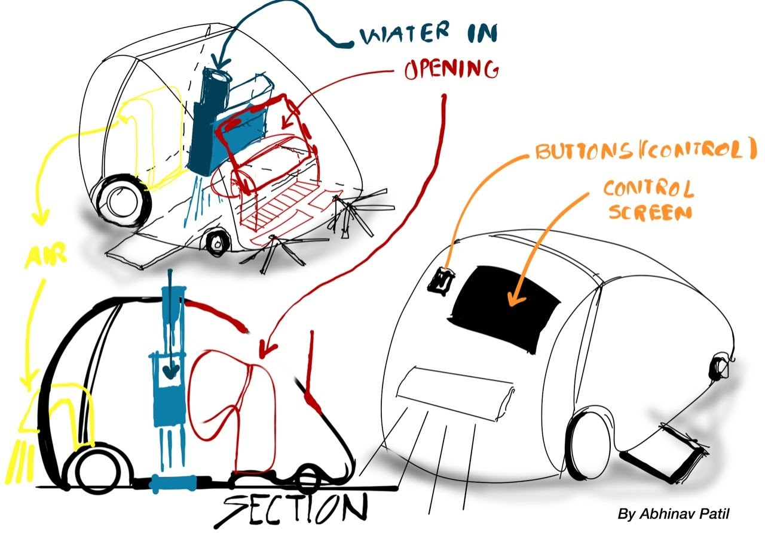

Slide 8
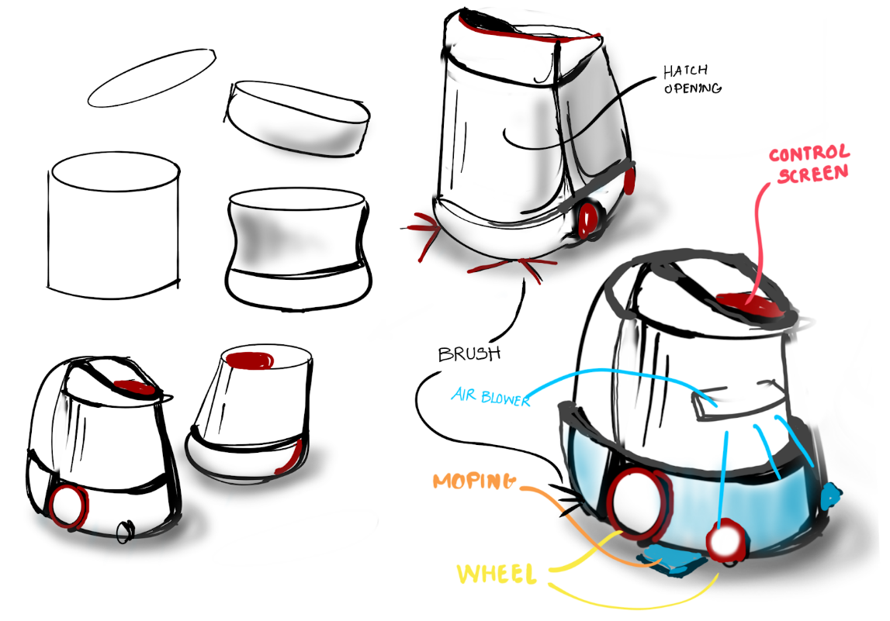

Slide 9
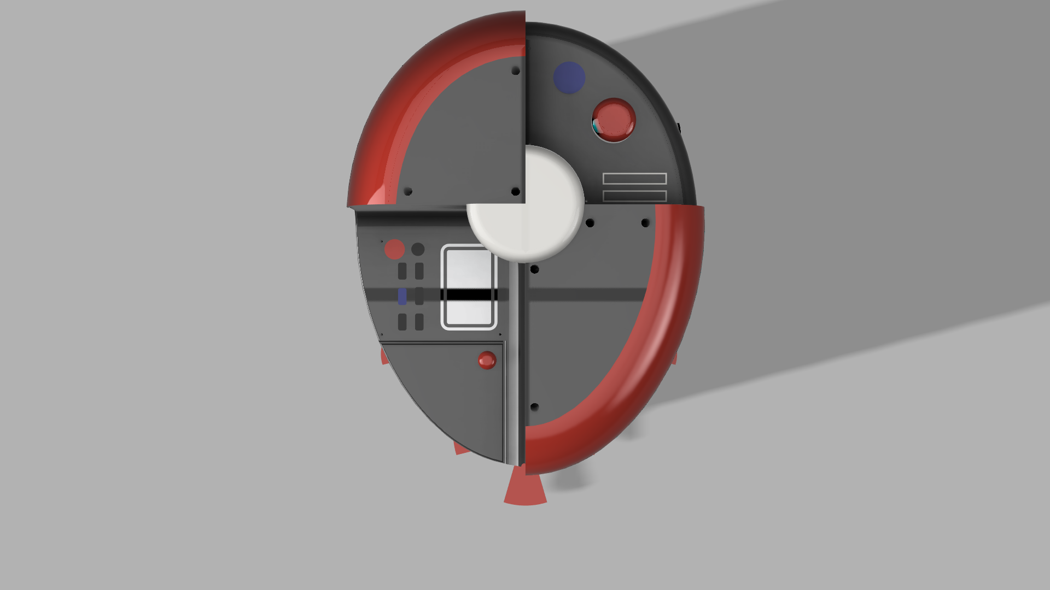
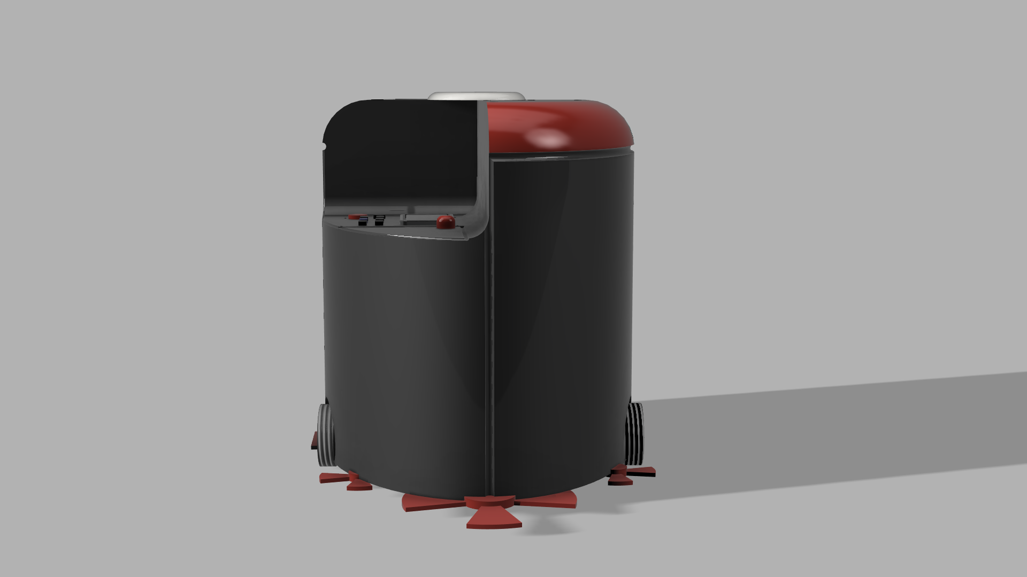
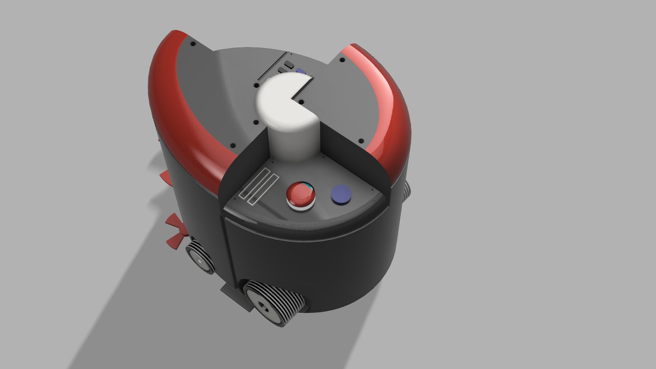


Slide 10
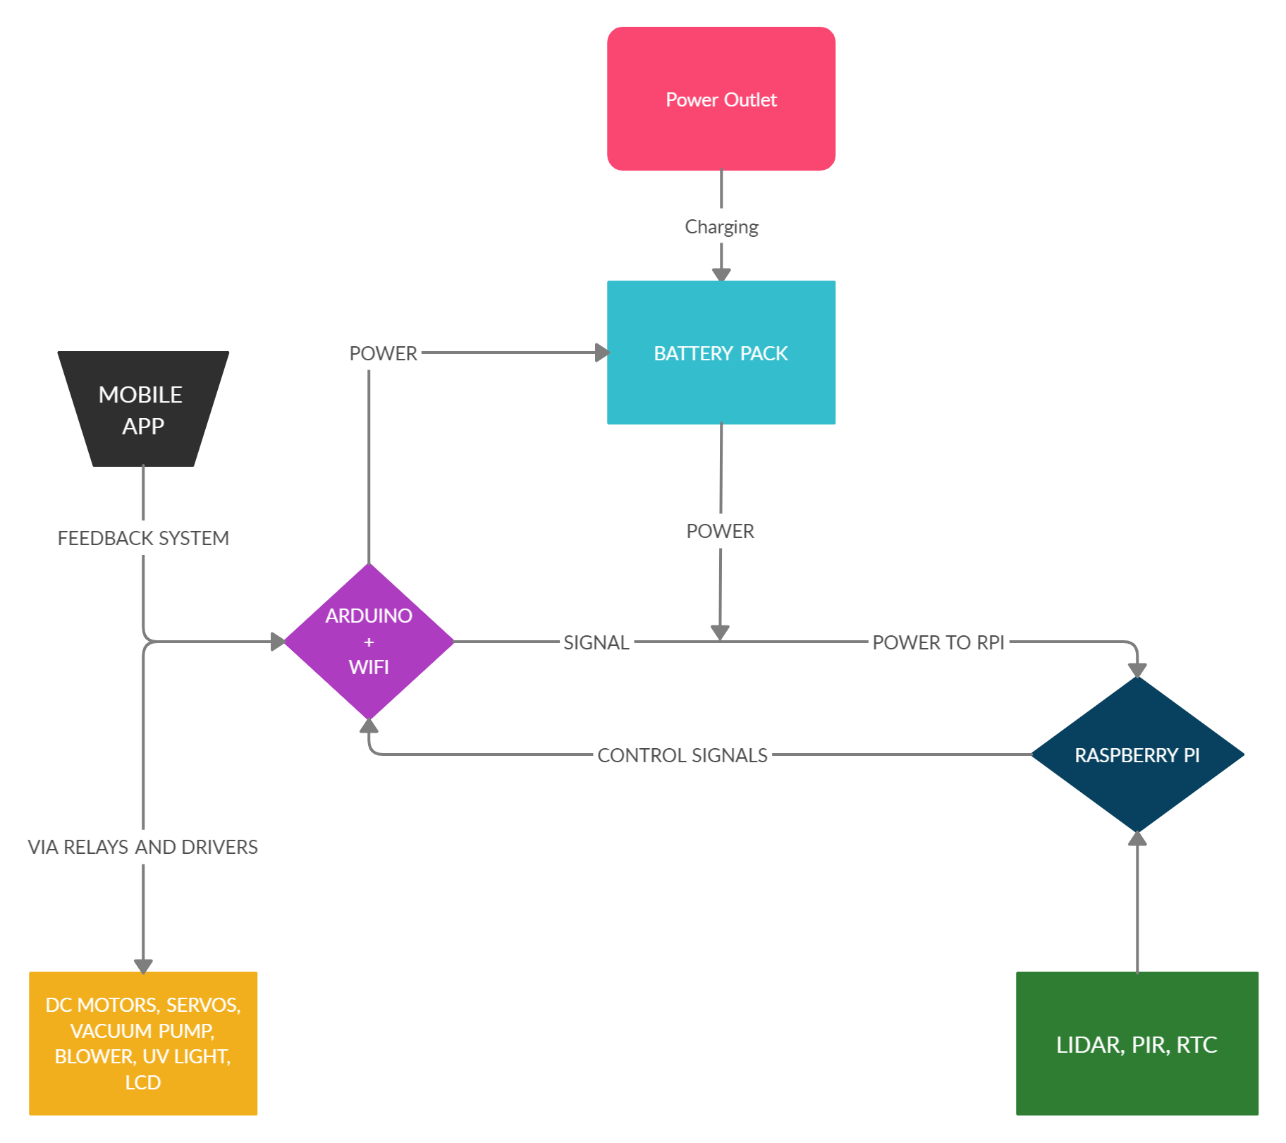
Circuit Block Layout

Slide 11
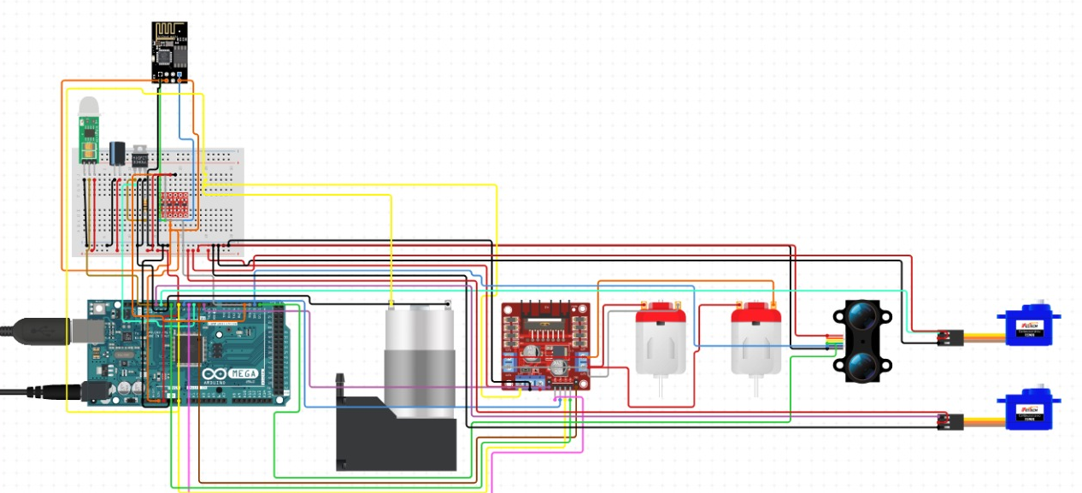
Circuit Diagram

Slide 12
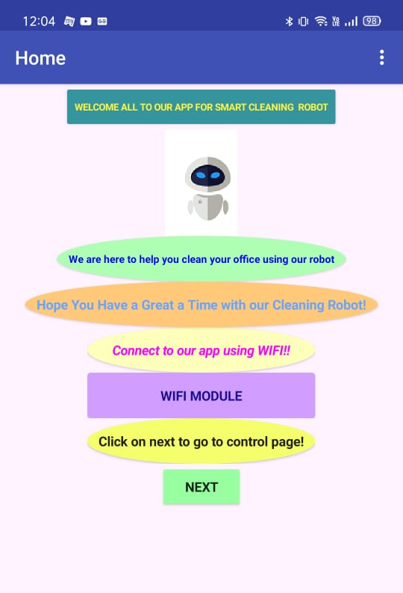
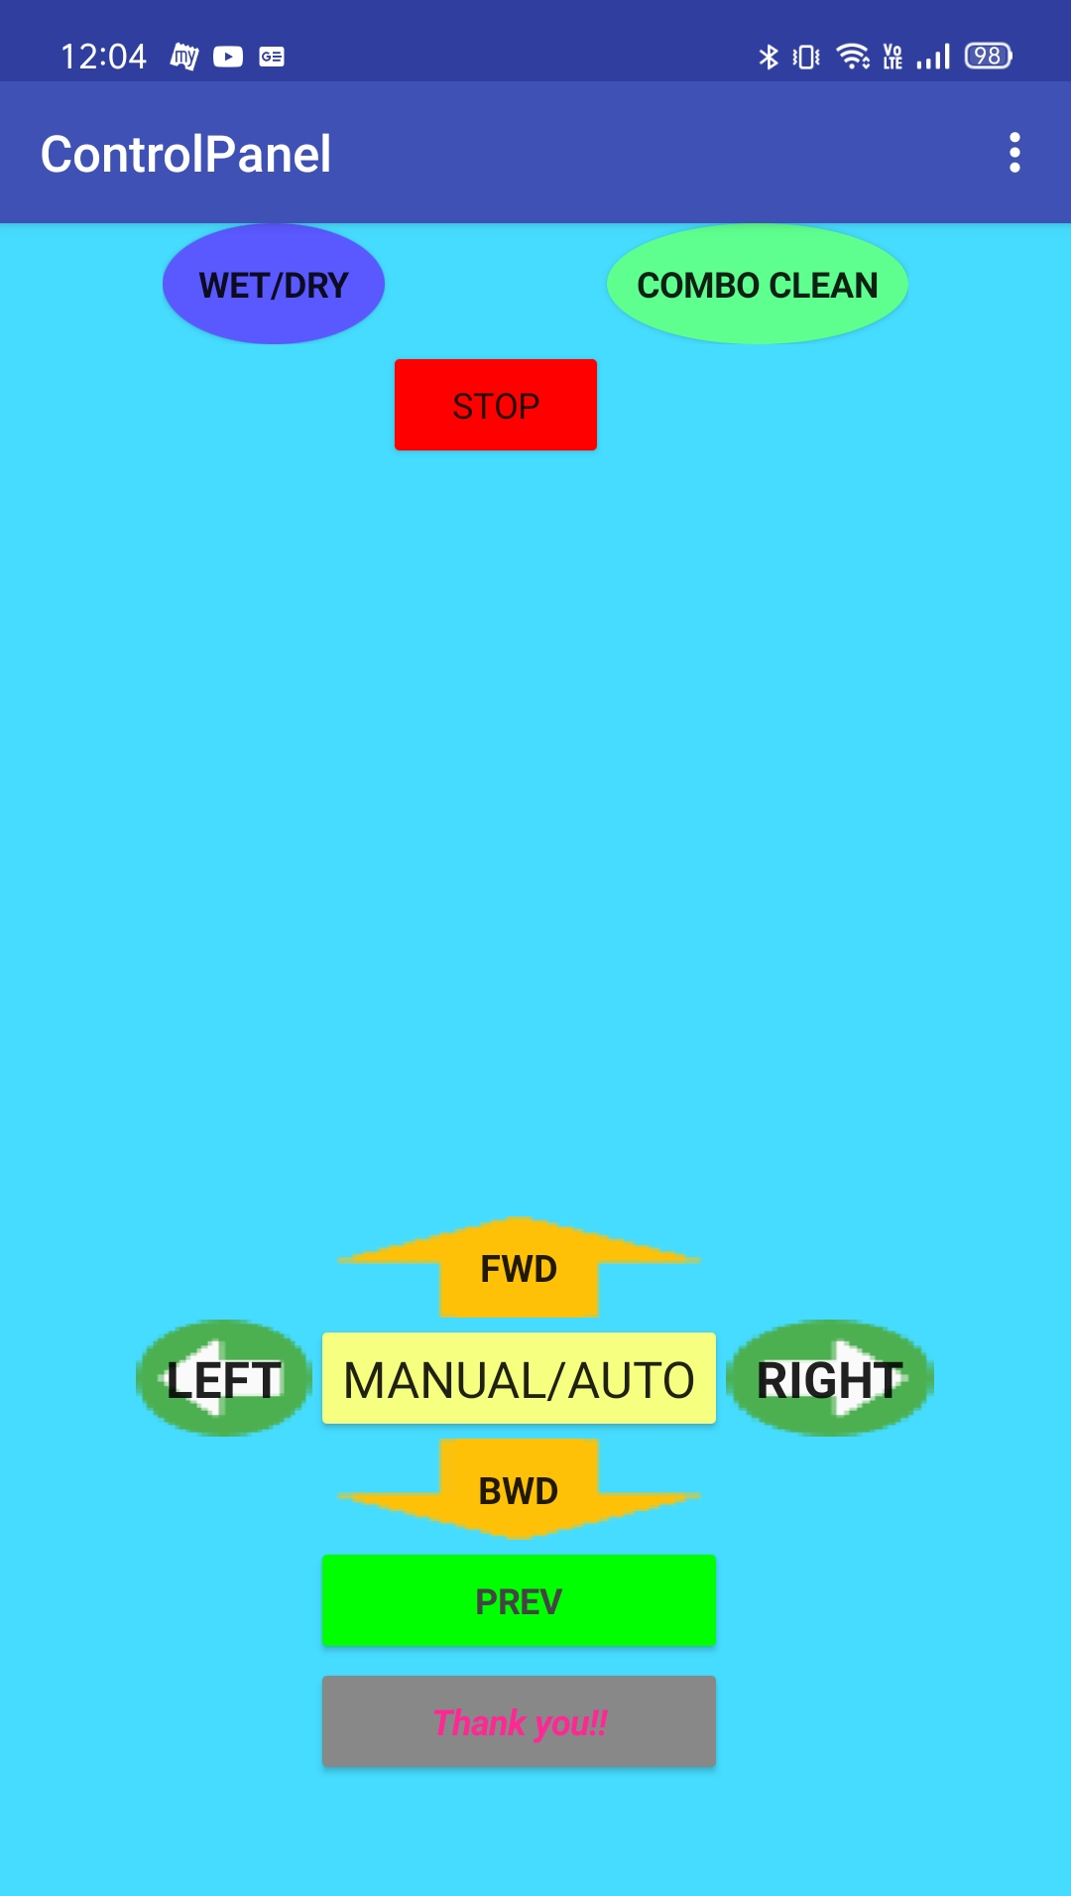
APP
INTERFACE

Slide 13
Estimated Budget
Electronics Components - Rs.15000
Manufacturing Cost - Rs.3000
Miscellaneous - Rs.2000
Total Estimated - Rs.20000

Slide 14
Project timeline
Week 1
Week 2
Week 3
Week 4
Research & Planning
Robot Design
And Circuit Preparation
Product Design,
Circuit Prep and
App Interface
Final Concept Presentation and Research Paper Publication

Slide 15
Thank you!

